Slide 1
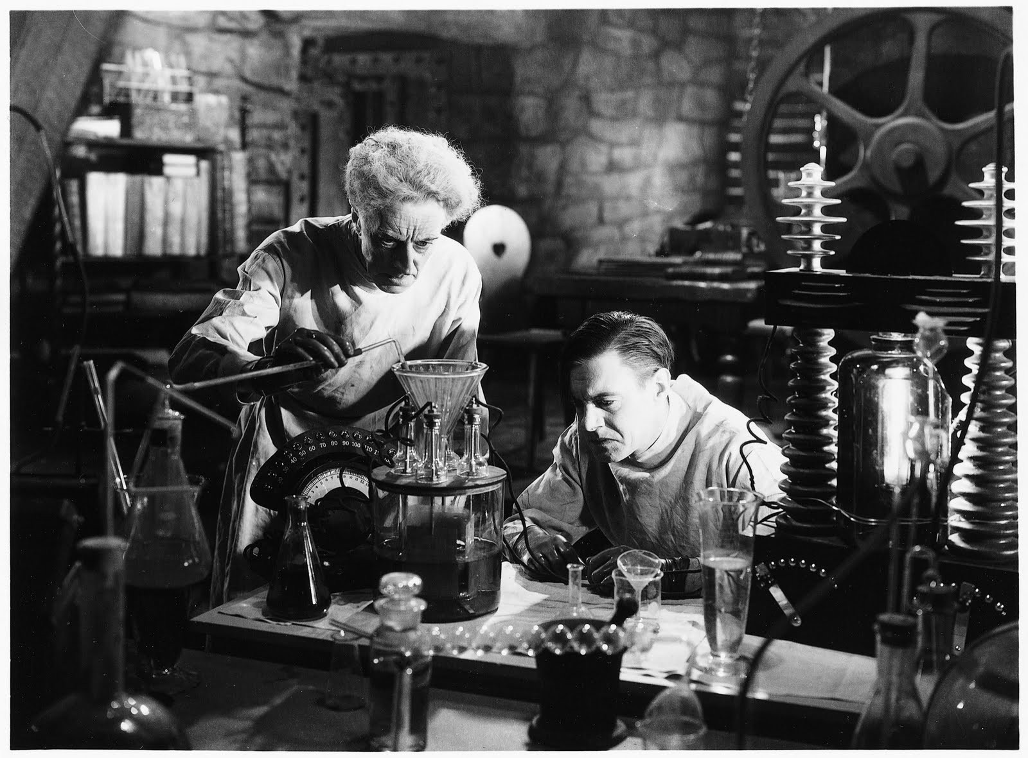
More Design and Operationalization

Slide 2
So let’s discuss variables
Independent Variable (IV)
Dependent Variable (IV)
Extraneous Variables

Slide 3
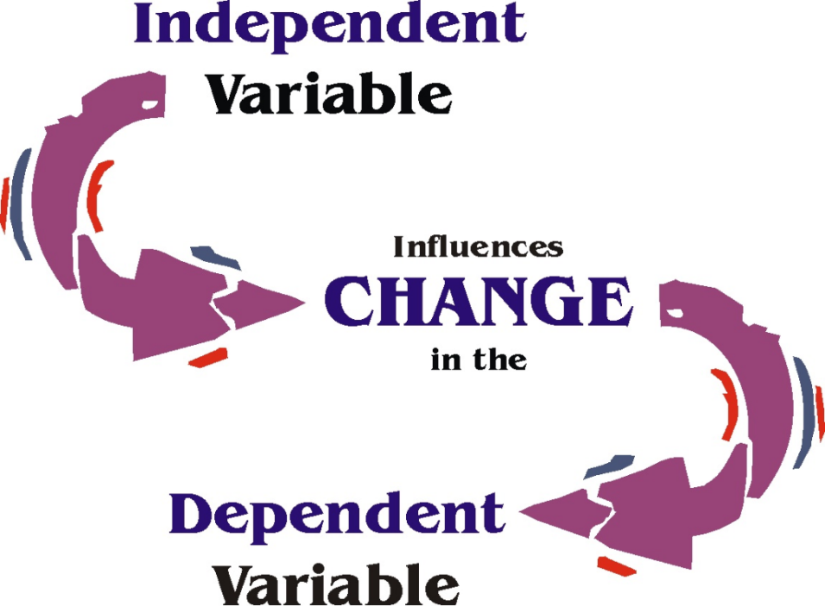
Manipulating the Independent Variable

Slide 4
Independent Variable Review
IV can be operationalized and manipulated through:
Straightforward manipulation
Staged (event) manipulation
Can have 2 or more levels (i.e., groups)
Manipulation strength depends on the difference between the groups/conditions

Slide 5
Measuring the Dependent Variable

Slide 6
Self-report Measures
Remember: Multiple measures of a variable provides a better picture than a single measure
Self-report
Asking participants to report on themselves
e.g., questionnaire on activities of daily living
Peer-report, Teacher-report, Parent-report
Asking peers, teachers, or parents to report on participant

Slide 7
Behavioral Measures
Behavioral
Direct observations of external behaviors
Does not include participants’ subjective beliefs
Can be observable behavior on paper or a computer, non-verbal behavior, verbal behavior, etc.
Ratings: how many times does behavior occur
Duration: how long does the behavior last?
Reaction time: how quickly response occurs after stimulus
Responses: e.g., how many responses are correct/incorrect?
Vary in their reliability and rater subjectivity

Slide 8
Physiological Measures
Galvanic skin response (GSR)
Electrical conductance of the skin, which changes when sweating occurs
Measures general emotional arousal and anxiety
Electromyogram (EMG)
Muscle tension
Measures tension or stress
Electroencephalogram (EEG)
Electrical activity of brain cells
Measures brain arousal in response to different stimuli
Functional MRI (fMRI)
Measures activation of brain regions in response to stimuli
Notes:
https://www.youtube.com/watch?v=dUM-qqRsTx8

Slide 9
Operationalization of DV Takes into account…

Slide 10
Pros and Cons of Modes of Measurement (Operationalization)
Self-Report,
Peer-Report,
Parent-Report,
Teacher-Report
Participants describe or rate themselves (or others) on some measure
e.g., happiness rating scale
Direct, easy, but subjective and could be biased or inaccurate
Physiological
Measure some aspect of the body or brain
e.g., blood pressure, EEG
Objective, but difficult to obtain, hard to relate to constructs, imprecise
Behavioral:
Researcher measures some aspect of observable behavior
e.g., # smiles, aggressiveness
e.g., Reaction time, EAR, # correct responses
Rated by researchers
Can be difficult to measure reliably. Rater subjectivity
Can be objective & reliable, but can still be influenced by situational factors
Measured by machine or algorithm

Slide 11
Sensitivity of the DV
The DV must be sensitive enough to detect differences between groups
Ceiling Effect
The independent variable appears to have no effect on the dependent measure because participants all reach the maximum performance level
Floor Effect
The opposite of the ceiling effect; the tasks is too difficult and all participants perform poorly

Slide 12
Cost of Measures
Self & other Report Surveys
Some behavioral measures
Observational behavioral measures
Physiological Measures
Inexpensive & Quick
Very Expensive & Time-Consuming
- Often administered online
- Administered online or in-lab
Administered in-lab or in real-world location
Administered in-lab or in real-world location
Notes:
Paper-and-pencil surveys = inexpensive
Some behavioral measures = variable, midrange
Video-taped interviews = expensive
Cost of equipment
Cost of multiple raters to review and rate observations
Time-consuming!
fMRI = very expensive
Training for administrator, interpreter, observer
Facilities
EQUIPMENT
Time-consuming! One participant per session

Slide 13

Experimenter Control & Extraneous variables

Slide 14
Types of Extraneous Variables
Environmental variables e.g. different rooms, weather, schools…
Participant variables e.g. Gender, age, IQ, family structure, SES…
Time-related variables e.g. Fatigue, time of study (day vs. night)…
Notes:
These can all serve to limit external validity

Slide 15
Confounding Variables
Extraneous variables that:
influence responses on the DV
vary systematically with the IV
We try to exert control in our experiment design to prevent extraneous variables from becoming confounds
Notes:
Extraneous variables are any variables that are present in the study that you are not measuring for the study. Every study has a slew of extraneous variables, and we usually account for these.
A confound is an extraneous variable that has two important characteristics: it influences the DV, and it varies systematically with the IV.
If your extraneous variable doesn’t influence the DV, then it isn’t a confound and you don’t have to worry about it.
There are three categories of confounding variables: READ BIG BULLET POINTS
General
Environmental variables
Group-related
Assignment bias occurs when the process used to assign different participants to different treatments produces groups of individuals with noticeably different characteristics
Time-related
Regression toward the mean: a mathematical phenomenon in which extreme scores (high or low) on one measurement tend to be less extreme on a second measurement. Regression is a threat to internal validity because changes that occur in participants’ scores from one treatment to the next can be caused by regression instead of the treatments.

Slide 16
Controlling Extraneous Variables
Two active control techniques:
Intentionally holding variables constant
Standardized environment and procedures (but may limit external/ecological validity)
Matching values across treatment conditions
Same number (each gender/age/etc.) in each condition
Same average score in each condition
Half of each treatment in each environmental condition
Vary order of treatment (but time consuming and tedious)
Notes:
There are three standard methods for controlling extraneous variables.
Two involve actively intervening to control variables, and they are:
Holding a variable constant
Standardize the environment: Hold one experimental session and test everyone at the same time under same conditions
Standardize the procedures: select only 19-year-old female athletes to participate in your experiment
Minimizes participant variables
MAY LIMIT EXTERNAL VALIDITY
2. Matching values across treatment conditions

Slide 17
Controlling Extraneous Variables
One passive control technique:
Randomization: Use a random process to disrupt the natural/systematic relationship between variables throughout the study
Randomize order of questions in a survey
Randomize order of trials in a task (e.g. Stroop)
Random assignment of participants to conditions
Notes:
Simpler technique
Using a random process (all different possible outcomes are equally as likely) to disrupt the natural/systematic relationship between two variables
Participant characteristics or environmental variables
Coin toss; draw knives (in Top Chef)
Random assignment: use of a random process to assign participants to treatment conditions
Chance may still create a biased situation

Slide 18
Comparing Methods of Control
Notes:
Column A: 10 treatments, 10 participants each. Gender confounded with treatment.
Column B: Gender held constant, so any differences cannot be due to gender
Column C: Gender matched across treatments
Column D: Gender randomized.
Active Methods (B & C) require more effort at the outset, so are used when a variable poses a real threat.
Holding a variable constant, has the distinct disadvantage of limiting generalizability.
Randomization is easier and controls for many things at once. However, it is not a fool-proof method.

Slide 19
Any experiment you design must have validity
Consideration for validity must be made when designing your study

Slide 20
Types of Validity
The extent to which the operational definition reflects the true theoretical meaning of the variable
Is the operational definition sufficiently measuring the construct it claims to measure?
Construct
The extent to which study produces a single, clear explanation for the relationship between variables
Have you ruled out confounding/third/extraneous variables?
Internal
The extent to which results can generalize to other populations and settings
Can the results be replicated with other participants or in other settings?
External
Ecological
The extent to which the experiment generalizes to the real world
Does the experiment reveal how people would behave in real life?
The extent to which the data actually support the conclusions that have been drawn
Do the statistics support the claims? Are analyses correct?
Conclusion
Notes:
Any component of a research study that introduces questions or raises doubts about the quality of the research or accuracy and generalizability of the results
Any time we cannot say for sure that there are no other causes for the effect we see in our results (internal validity), or if there is something that prevents us from generalizing our results to the larger population (external validity), we then have a threat to validity.
THREAT TO EXTERNAL VALIDITY Any characteristic of a study that limits your ability to generalize the results to other people/settings
Participant variables: Was your sample representative of the larger population of interest?
Ecological validity: Was the experimental setting representative of the real world activity of interest, or was it unnatural and artificial?
THREAT TO INTERNAL VALIDITY Any factor that allows for an alternative explanation of the observed pattern of results

Slide 21
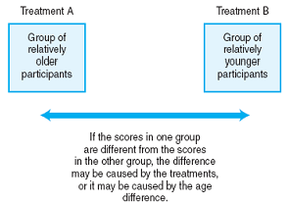
Individual Differences as Confounds
Groups should be equivalent except for the level of the IV, so you must control for:
Assignment bias
Environmental variables
Equivalent groups are:
Created equally
Treated equally
Composed of equivalent individuals
Notes:
So let’s talk about Individual Differences as Confounds
In our design, we are assigning individuals to different groups and subjecting them to separate treatment conditions.
Assumption is participants are all similar EXCEPT for which treatment condition they’re in
If, by chance, the random assignment results in one group being generally older than the other group (or smarter, taller, sicker, etc.), then we have what we call an assignment bias and this results in the introduction of a possible confound.
There is also the threat of confounds from environmental variables – if we test one group in a large room and one group in a small room (or cold/hot, bright/dim, etc.), this might influence the results we obtain from each group.
To protect against assignment bias, we control our group assignments to ensure that separate groups are:
Created equally – the process to obtain participants is the same for all groups
Treated equally – except for the treatment conditions
Composed of equivalent individuals – make sure characteristics are all the same
Random assignment
Restricted random assignment
Holding variables constant
Restricting range of variability
Matched groups (assignment)
Identify variable to be matched
Measure this variable for each participant
Assign to groups by means of restricted random assignment
So how do we establish equivalent groups of participants?
We use the same control techniques we discussed in the last chapter:
active technique: random assignment EXPLAIN
however, now that we have groups in our design, we must ensure that we have an equal number in each group.
To do this, we utilize restricted random assignment, in which we limit the assignment process to ensure a predetermined characteristic (in this case – equal size) for each of the groups.
two passive techniques: matching and holding variables constant
Holding variable constant: if we are concerned that gender would be a confound, we eliminate this using only one gender.
Alternative to holding a variable constant is to restrict its range of variation.
Similar to “dumping” a gender – if we are concerned that IQ levels may confound an experiment, we restrict the range we allow to a narrow range (i.e. 100 to 110) to ensure equal IQ levels.
Matched assignment
Same as last chapter

Slide 22
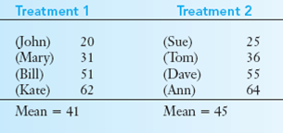
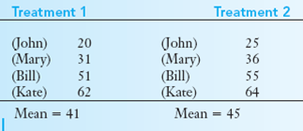
*A Note on Individual Differences
While within-subject designs have fewer individual differences in comparison with between-subjects designs…
Between-Sub: 8 unique individuals
Within-Sub: 4 unique individuals
… The design does not eliminate them (John, Mary, Bill, and Kate are still all different individuals).
The design allows us to be able to measure and remove them with statistical analysis, but they do exist.

Slide 23
Within- vs. Between-subjects Designs
Individual differences
Problem: May become confounding variables or increase variance
Solution: Within-subjects designs reduce this variance
Time-related factors and order effects
Problem: May distort results
Solution: Between-subjects designs only measure each individual once (or on one level of the IV)
Number of participants
Problem: Some populations are hard to recruit or costly
Solution: Within-subjects designs require fewer participants

Slide 24
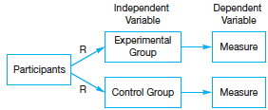
Posttest-only Design
Two equivalent groups of participants
Introduction of the independent variable
Measure effect of the IV on the DV

Slide 25
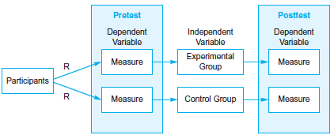
Pretest-Posttest Design
A pretest is given to each group prior to introduction of the experimental manipulation
Assures that groups are equivalent at the beginning of the experiment
Can quickly measure changes that occur from pretest to the posttest

Slide 26
Pretest-Posttest Design
Advantages
Disadvantages
Can evaluate Attrition/Mortality (dropout factor)
Assess equivalency of groups with small sample size
Can be used to select participants for the experiment
Can be time consuming and awkward to administer
Sensitizes participants to what is being studied (practice effects)
Can tip off participants to purpose of study (demand characteristics)

Slide 27
Other Threats to Internal Validity
Differential Attrition
e.g., Mortality differences between groups → groups are no longer equal
Communication Between Groups
Can compromise integrity of study
Notes:
Remember goal of between-subjects experimental design is to look for differences between groups on the DV and to demonstrate that these differences are caused by changes in the IV
Whenever there is a question about what caused the changes in the DV (aside from the IV), we have a threat to the internal validity.
We already talked about the threat individual differences and environmental variables pose to the internal validity of a study.
In addition to these, there are threats from:
Attrition: participants withdraw from the study before it is completed
Always some attrition, but when it is so many that the numbers making up the groups becomes noticeably different, we have differential attrition.
Any differences between groups might be explained to group differences on attrition
Why did certain people leave? Why did they stay?
Communication between groups: participants from one group talks to participants of another group
Diffusion occurs when the treatment effects spreads from one group to the control, reducing the difference between the two conditions
Cognitive behavior therapy to treat depression
Compensatory equalization happens (usually in clinical trials) when one group learns that the other is receiving a certain treatment, and demands the same for itself.
Study on TV violence – one group learns the other is allowed to watch Batman, insists on watching it themselves
School studies testing effectiveness of pre-K programs
Medical trials
Compensatory rivalry happens when participants in an untreated group learn that special treatment is given to another group and change their behavior so that they too receive the treatment
Minimizes effect of treatment
Resentful demoralization happens when the untreated group gives up when they learn that they are not getting the same special treatment that the other group is getting.
Effect of treatment seems a lot more than it is

Slide 28
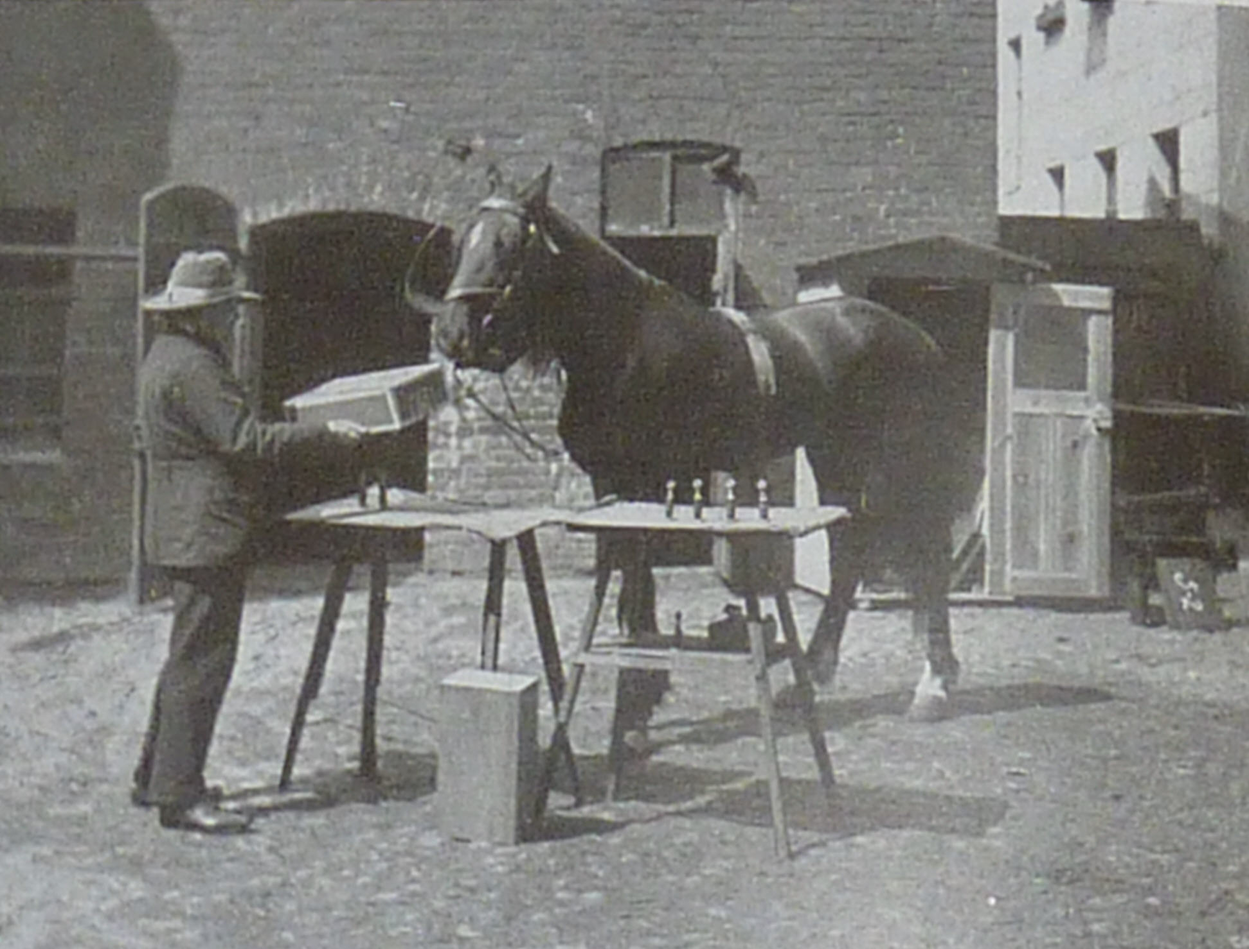
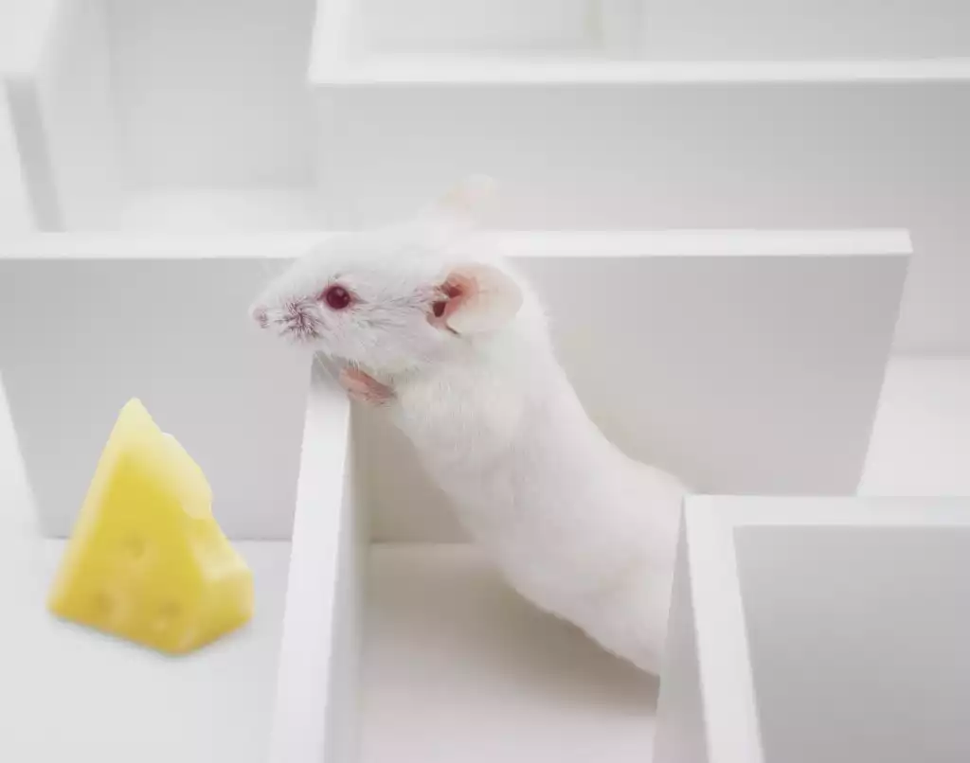
Experimenter Expectancy Effects AKA Observer Expectancy Effects AKA Observer Effect AKA Experimenter Bias
Clever Hans
Rosenthal & Fode, 1963
Notes:
Rosenthal is well known for his research on experimenter expectancy effects, the influence that a researcher can exert on the outcome of a research investigation. Perhaps the most famous case of an experimenter expectancy effect is the case of Clever Hans (as discussed earlier in class). Rosenthal and Fode (1963) attempted to demonstrate this phenomenon in the context of controlled laboratory research. In one of his early experiments, he tested the effects of experimenter expectancy on maze-running performance. He had two groups of students test rats, wrongly informing them either that the rats were specially bred to be "maze dull" or "maze bright." In reality, all rats were standard lab rats, and were randomly assigned to the "dull" and "bright" conditions. The results showed that the rats labeled as "bright" learned the mazes more quickly than those labeled as "dull." Apparently, students had unconsciously influenced the performance of their rats, depending on what they had been told. Rosenthal reasoned that a similar effect might occur with teachers' expectations of student performance.

Slide 29
Controlling for Experimenter Expectations
Single-blind experiment: Participant unaware of condition
Double-blind experiment: participant and experimenter both unaware of condition
Notes:
.

Slide 30
Types of Validity
The extent to which the operational definition reflects the true theoretical meaning of the variable
Is the operational definition sufficiently measuring the construct it claims to measure?
Construct
The extent to which study produces a single, clear explanation for the relationship between variables
Have you ruled out confounding/third/extraneous variables?
Internal
The extent to which results can generalize to other populations and settings
Can the results be replicated with other participants or in other settings?
External
Ecological
The extent to which the experiment generalizes to the real world
Does the experiment reveal how people would behave in real life?
The extent to which the data actually support the conclusions that have been drawn
Do the statistics support the claims? Are analyses correct?
Conclusion
Notes:
Other threats to validity relate to your participants….

Slide 31
Sampling Procedures
Who are your participants?

Slide 32

Sampling
What is she doing?
Population = all of the individuals of interest to the researcher
Sample = a selection of participants from the population
Sampling = how participants are selected to be in your sample

Slide 33
When Selecting Participants
Samples may be drawn from the population using
Probability sampling vs. non-probability sampling
Sampling must assure external validity to generalize to other populations
Determine the needed sample size
Conduct a power analysis once you have determined your variables of interest
Larger samples provide more accurate estimates of population values!

Slide 34
Importance of Sampling
Type of sampling influences conclusions that can be drawn about your results:
Generally, we can make conclusions about relationships between variables regardless of the sample
But we can only make generalizations to the population in representative (probability) samples
Beyond who is asked to participate, we must also consider who agrees to participate (e.g., low participation rates can lead to distorted findings)

Slide 35
Probability Sampling
We do know how likely it is that any particular member of a population will be chosen
Simple random sampling = every member of a population has an equal chance of being selected
Stratified random sampling = population is divided into meaningful groups (age, sex, ethnicity) and then samples are randomly selected from these groups
Notes:
Use a complete list of all students

Slide 36
Nonprobability Sampling
Sample where we do not know how likely it is that any particular member of a population will be chosen
Haphazard sampling = whoever you can find walking across campus (a convenience sample)
Quota sampling = choose a sample that represents the numerical composition of various population subgroups (e.g. selecting 60% White, 20% African American, 10% Latino, 8% Asian participants from people walking across campus).
Fine if interested in relationships between variables, but can problematic if you want to generalize to whole population
Most research in psychology uses nonprobability sampling!

Slide 37
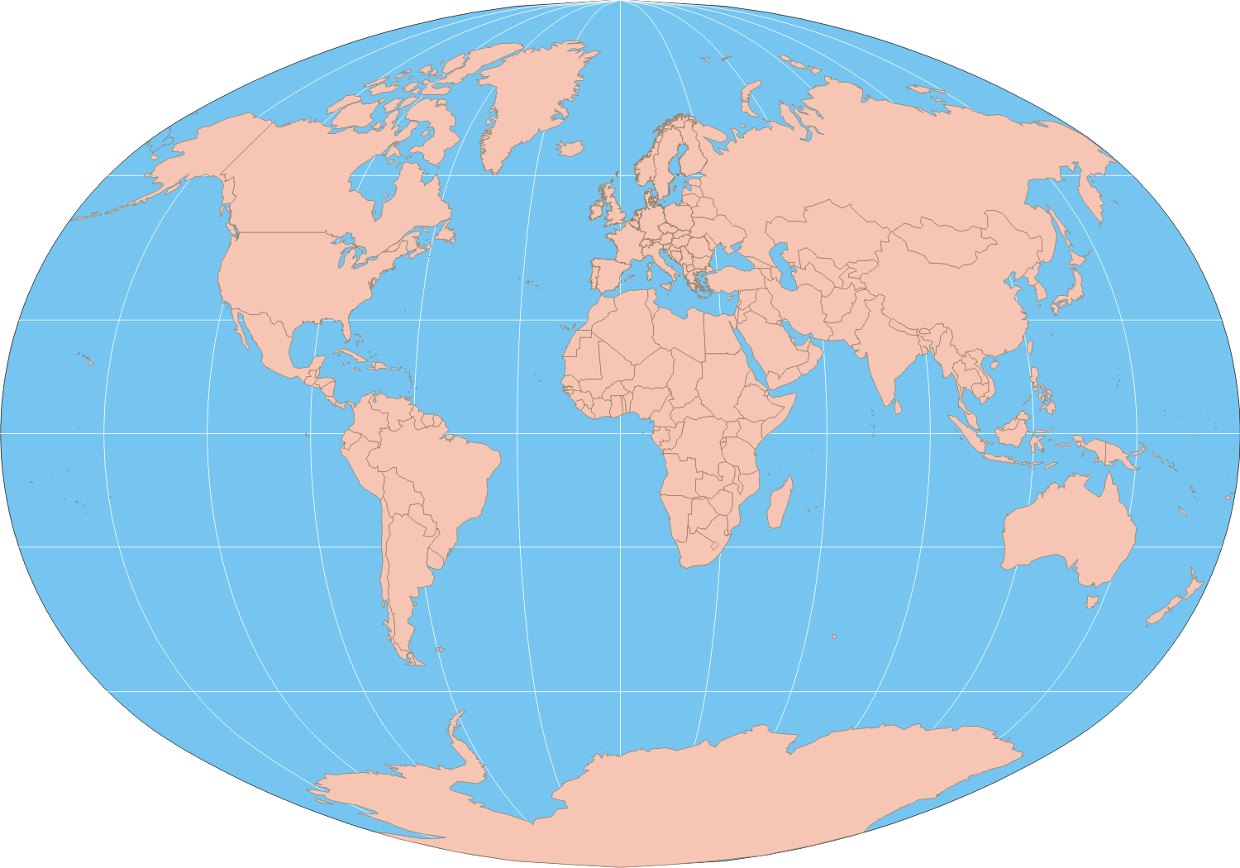
W.E.I.R.D. Societies Henrich, Heine, & Norenzayan, 2010
Western
E. European
I. Industrialized
R. Rich
D. Democratic

Slide 38
Participate in our next study
https://purchasenss.qualtrics.com/jfe/form/SV_3xAk5oj8tZacsLz

